Slide 1

Indian Institute of Information Technology, Nagpur
Object Oriented Programming Lab-Project Submission
Project Presentation (3 November 2023)
On
“SUPERMARKET MANAGEMENT SYSTEM”
by
MR. UMESH MANIKANTA(BT22CSD027)
MR. NIKHIL KRISHNA(BT22CSD022)
MR. SOWMITH REDDY(BT22CSD025)
Department of CSE, IIITN

Slide 2
Index
Problem statement Details
Datasets & Preprocessing
Flowchart
Output
Related Work
Future Work
References

Slide 3
PROBLEM STATEMENT
Managing a simple retail store's operations. It allows users to log in, check the stock of products, add new stock, and generate bills for customers.

Slide 4
DATASETS & PRE-PROCESSING
The code reads product data from a CSV file named "DMart.csv." The product data includes product names, prices, and quantities. It pre processes the data by cleaning and parsing it, ensuring that prices and quantities are in the correct format.
FLOWCHART
A flowchart represents the code's execution flow. It starts with the main function, which handles user authentication. Once logged in, the program provides options for stock checking, adding new stock, and billing. These options have their respective functions and interact with the CSV file for data operations.

Slide 5
Start
|
|--> Main Function
| |
| |--> Authentication (Login)
| |
| |--> Options: Stock Checking, Adding New Stock, Billing
| | |
| | |--> Stock Checking Function
| | |
| | |--> Adding New Stock Function
| | |
| | |--> Billing Function
| |
| |--> Continue or Exit
| |--> Sales Tracking
|
|--> End

Slide 6

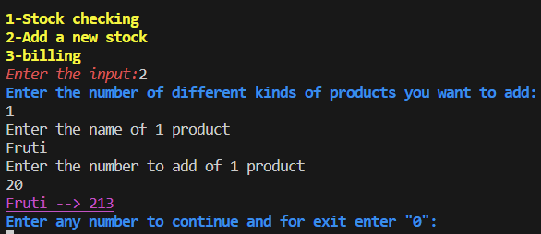
OUTPUT
The code outputs various messages and results to the console. It also generates bill files for customers, which include product details, total amounts, and other information. The bills are stored with customer names as file names.
ADD STOCK FUNCTION

Slide 7
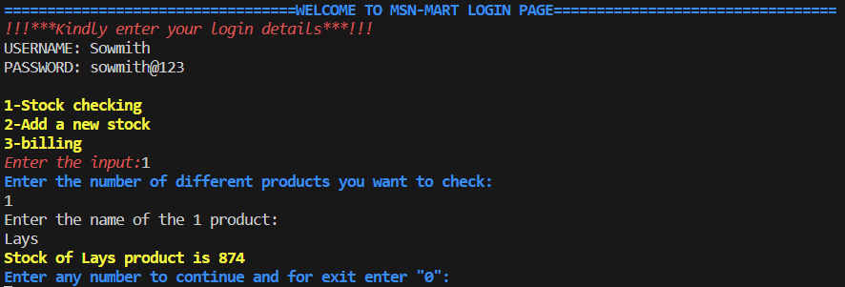
STOCK CHECKING FUNCTION

Slide 8
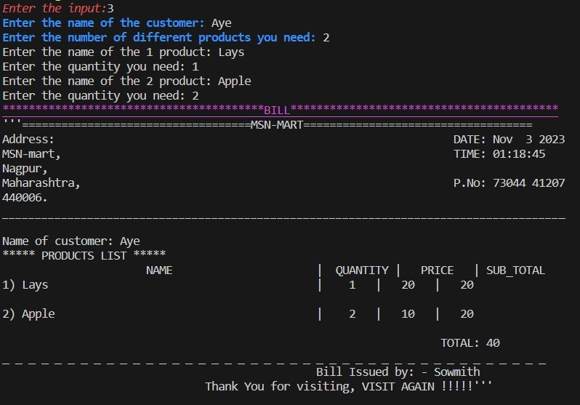
BILLING FUNCTION

Slide 9
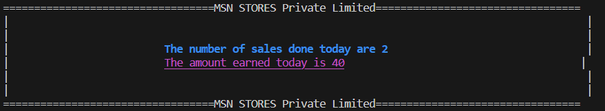
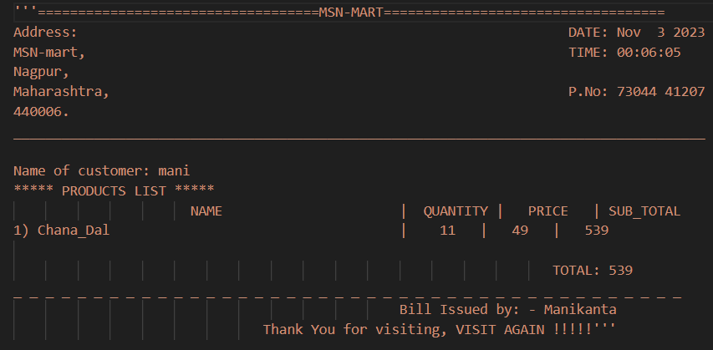
BILL FILE
Sales tracking

Slide 10
FUTURE WORK
Possible future improvements and features for the code may include:
Database Integration: Replace the CSV file with a relational database for better data management and scalability.
User Management: Implement user roles and permissions to control access and actions.
Product Categories: Add support for product categories and filtering.
Inventory Alerts: Implement notifications for low-stock products.
Reporting: Generate sales reports and analytics.
User Interface: Create a graphical user interface (GUI) for a more user-friendly experience.

Slide 11
REFERENCES
1. C++ Standard Library
2. C++ File Input/Output
3. C++ Programming Tutorials and Resources
CONCLUSION
In conclusion, the MSN-MART project is a commendable effort in developing a C++based retail management system. It offers essential functionalities for user authentication, stock management, and billing. However, there is significant potential for further development and enhancement.

Slide 12
Thank You

